Slide 1
Mid-Point Project Presentation
Social Modifications
Keith Feeney
15015556
17 December 2018

Slide 2
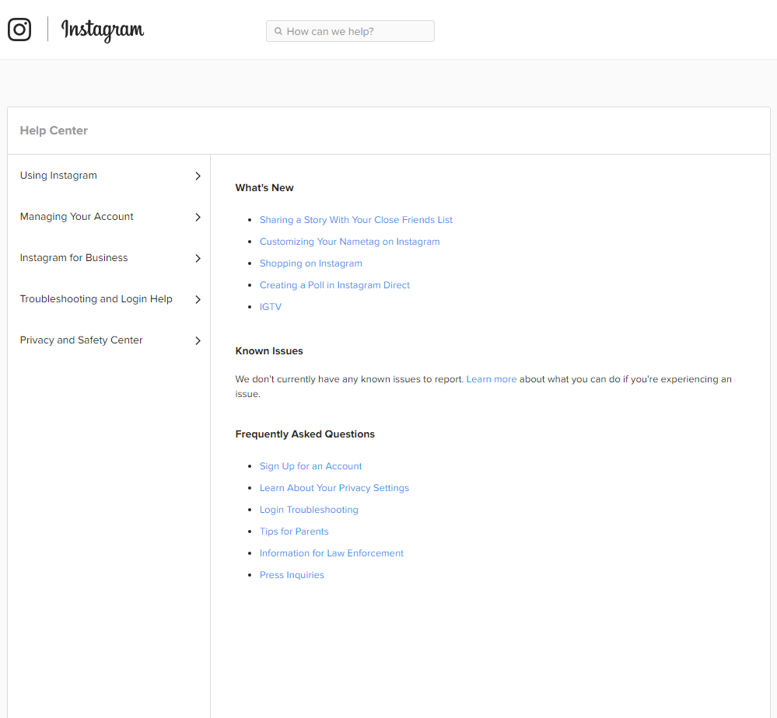
Introduction
Keith Feeney
Final year student at NCI
Social Modifications
Web Application & Android app
People over 18
Tattoos & piercings (modified people)
Help sections on social media
Artificial Intelligence
(Instagram, 2018)

Slide 3
Project Goals
Creating a web application & Android app
Research show little social networks for modified people
Help sections on current social networks
Artificial Intelligence
People aged 18 to 35 who have an interest in tattoos

Slide 4
Technologies to be used
Web application:
NetBeans
Maven (build automation tool)
Java
Web technologies like HTML, JavaScript & XML
Android app:
Android Studio
C++
XML
Other standard Android technologies
Google Firebase:
Database
File Storage

Slide 5
Requirements
Functional:
Create/Edit Profile
Update/Delete media
Send message
Group chat
Chat with ChatBot (Help section)
Rate Tattoo Shops
Non-functional:
Performance/Response time
Availability
Recoverability
Security
Usability

Slide 6
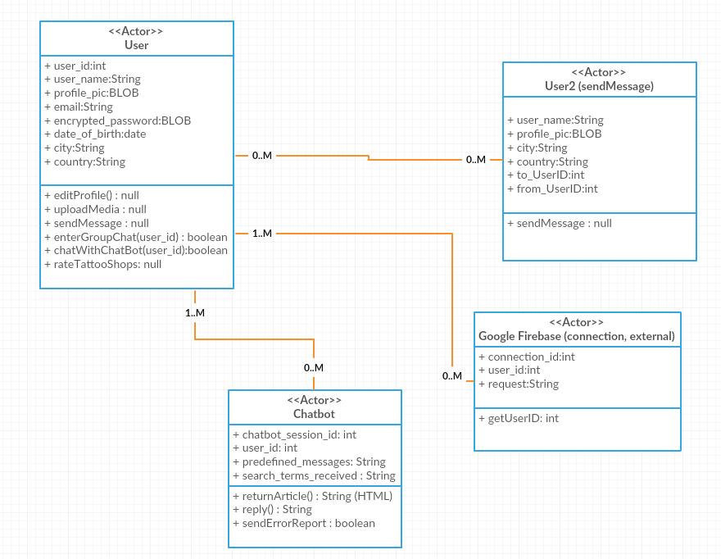
Architecture

Slide 7
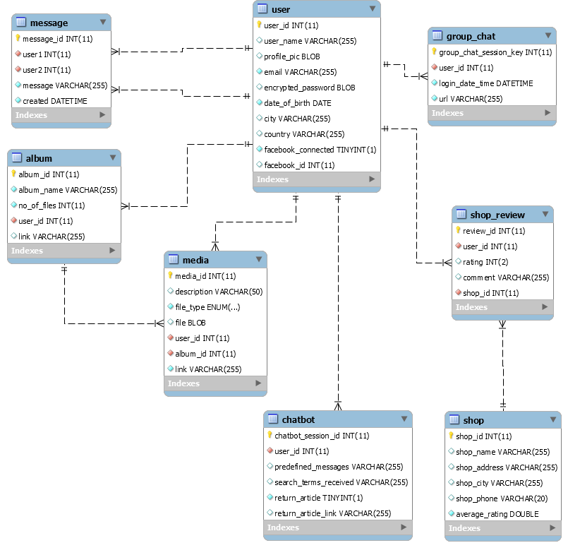
Database

Slide 8
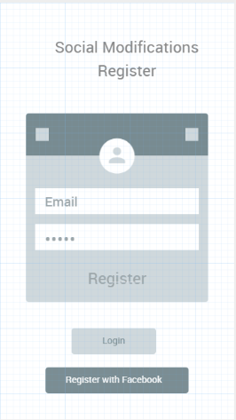
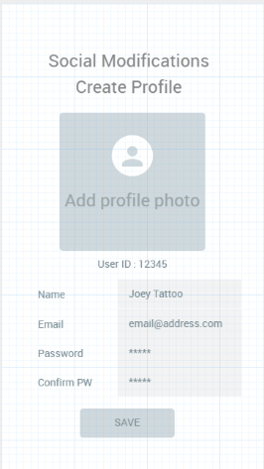
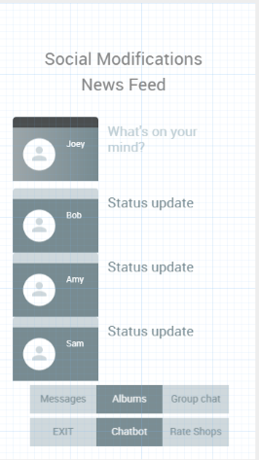
GUI

Slide 9
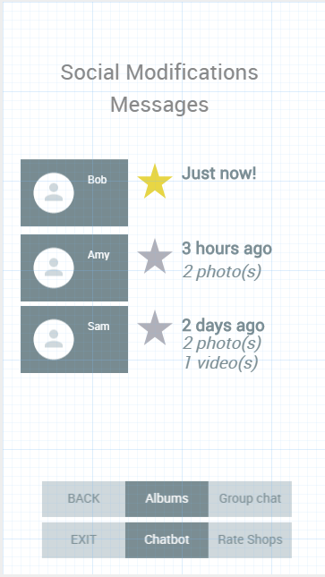
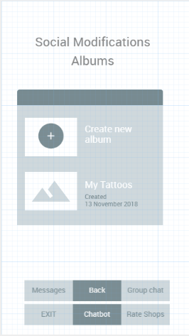
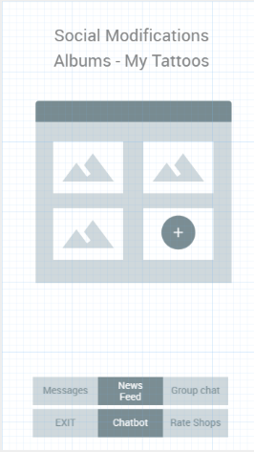
GUI

Slide 10
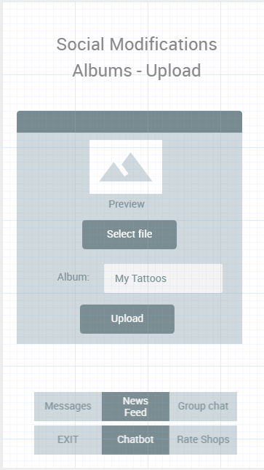
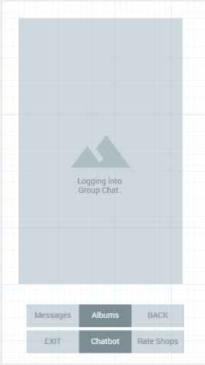
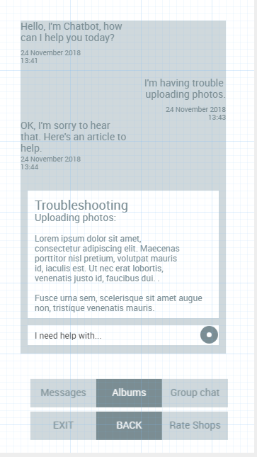
GUI

Slide 11
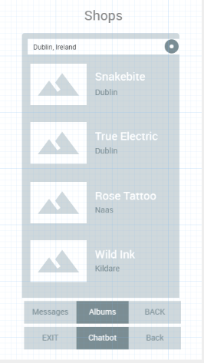
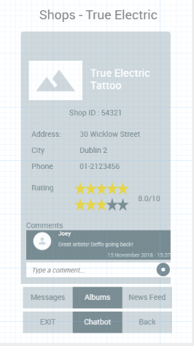
GUI

Slide 12
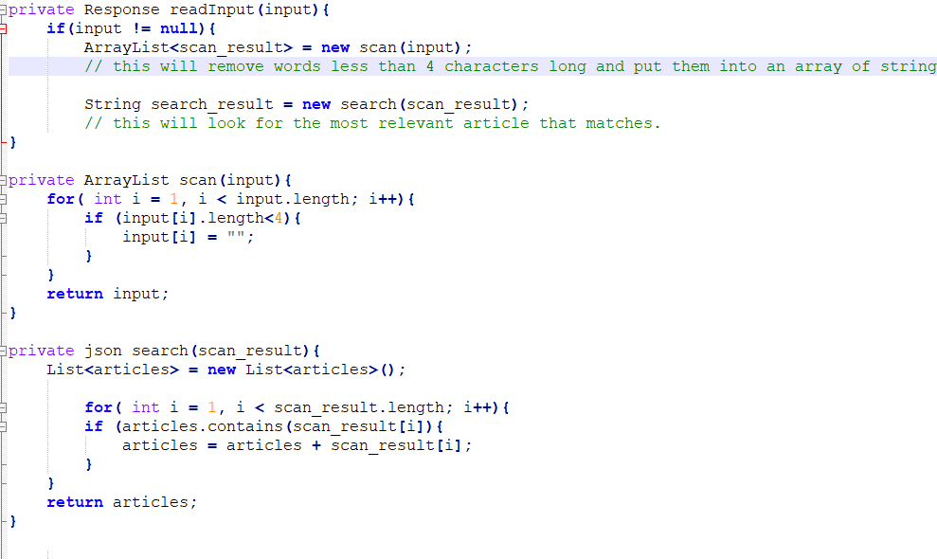
Example code for the ChatBot

Slide 13
Conclusion
Where the Project is currently at
Difficulties
Evaluation
Result
Continuation

Slide 14
Questions
?

